Slide 1
MULTIPLAYER HANGMAN GAME
GROUP MEMBERS
MICHAEL LING CHEE SIANG CB12082
NG KE HUEY CB12098
NUR SYUHAIDAH BINTI ISMAIL CB13006
MAHDI HISHAMUDDIN BIN ABDUL AZIZI CB13009

Slide 2
TOPIC PRESENTED
Project Background
Database Design
Web Application Theory Applied
Demo

Slide 3
PROJECT BACKGROUND
In this game, player must reveal the hidden word before running out of chance. Each time player makes a wrong guess, the chances will be decreased by one. As ‘hangman’ has 6 different body parts (to-be-hanged), so total chances of 6 will be given to player when player clicks to start new game. Every correct guess is an addition of 20% while any wrong guesses will be a deduction of 10%.
To make this game more interesting, a multiplayer system has been developed. Player is not allowed to play this game unless he/she was challenged by other players. Every player can challenge other players except himself. To send a challenge, player has to select other players’ username and assign a word/phrase either from system database or own. There is no limit for number of challenges to be accepted by player.

Slide 4

DATABASE DESIGN
tblUser
tbl
Challenge
tbl Scoreboard
HANGMAN GAME

Slide 5
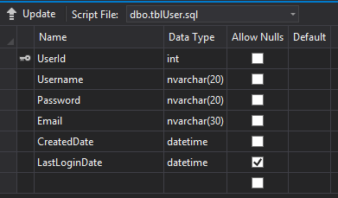
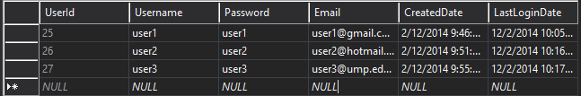
tblUser

Slide 6
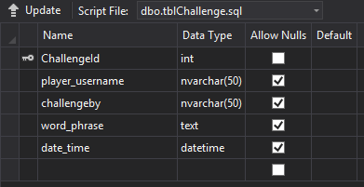

tblChallenge

Slide 7
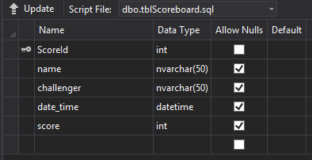
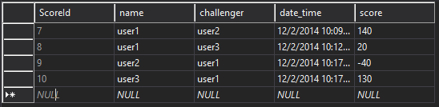
tblScoreboard

Slide 8
WEB APPLICATION THEORY APPLIED
Validation Web Controls
Required Field Validator
Compare Validator
Regular Expression Validator

Slide 9
Dropdown list Search
Grid View Table
Applications of Grid View

Slide 10

MULTIPLAYER HANGMAN GAME

